Slide 1
SWE 1010 PROJECT REVIEW-3 DIGITAL IMAGE PROCESSING Recognition of Hand Movement for a Paralytic Person Using Convolutional Neural Network
MEMBERS:
P. Nageswararao (20MIS1006)
M. Srikanth (20MIS1086)
Ch. jaya venkatesh
FACULTY:
Dr. Geetha balan.s

Slide 2
Implementation:
Now, lets implement a 3D convolutional Neural network on this dataset. To use 2D convolutions, we first convert every image into a 3D shape : width, height, channels. Channels represents the slices of Red, Green, and Blue layers. So it is set as 3. In the similar manner, we will convert the input dataset into 4D shape in order to use 3D convolution for : length, breadth, height, channel (r/g/b).
Note: even though the input images are rgb (3 channel), we will perform image processing on each frame and the end individual frame will be grayscale (1 channel) for some models
Lets create the model architecture. The architecture is described below:
While we tried with multiple filter size, bigger filter size is resource intensive and we have done most experiment with 3*3 filter
We have used Adam optimizer with its default settings. We have additionally used the ReduceLROnPlateau to reduce our learning alpha after 2 epoch on the result plateauing.
Build a 3D convolutional network, based loosely on C3D.

Slide 3
Input and Output layers:
One Input layer with dimentions 30, 120, 120, 3
Output layer with dimentions 5
Convolutions :
Apply 4 Convolutional layer with increasing order of filter size (standard size : 8, 16, 32, 64) and fixed kernel size = (3, 3, 3)
Apply 2 Max Pooling layers, one after 2nd convolutional layer and one after fourth convolutional layer.
MLP (Multi Layer Perceptron) architecture:
Batch normalization on convolutiona architecture
Dense layers with 2 layers followed by dropout to avoid overfitting

Slide 4
CODING:
import cv2
import numpy as np
import math
cap = cv2.VideoCapture(0)
while(1):
try: #an error comes if it does not find anything in window as it cannot find contour of max area
#therefore this try error statement
ret, frame = cap.read()
frame=cv2.flip(frame,1)
kernel = np.ones((3,3),np.uint8)
#define region of interest
roi=frame[100:300, 100:300]
cv2.rectangle(frame,(100,100),(300,300),(0,255,0),0)
hsv = cv2.cvtColor(roi, cv2.COLOR_BGR2HSV)

Slide 5
# define range of skin color in HSV
lower_skin = np.array([0,20,70], dtype=np.uint8)
upper_skin = np.array([20,255,255], dtype=np.uint8)
#extract skin colur imagw
mask = cv2.inRange(hsv, lower_skin, upper_skin)
#extrapolate the hand to fill dark spots within
mask = cv2.dilate(mask,kernel,iterations = 4)
#blur the image
mask = cv2.GaussianBlur(mask,(5,5),100)
#find contours
contours,hierarchy= cv2.findContours(mask,cv2.RETR_TREE,cv2.CHAIN_APPROX_SIMPLE)
#find contour of max area(hand)
cnt = max(contours, key = lambda x: cv2.contourArea(x))
#approx the contour a little
epsilon = 0.0005*cv2.arcLength(cnt,True)
approx= cv2.approxPolyDP(cnt,epsilon,True)

Slide 6
#make convex hull around hand
hull = cv2.convexHull(cnt)
#define area of hull and area of hand
areahull = cv2.contourArea(hull)
areacnt = cv2.contourArea(cnt)
#find the percentage of area not covered by hand in convex hull
arearatio=((areahull-areacnt)/areacnt)*100
#find the defects in convex hull with respect to hand
hull = cv2.convexHull(approx, returnPoints=False)
defects = cv2.convexityDefects(approx, hull)
# l = no. of defects
l=0
#code for finding no. of defects due to fingers
for i in range(defects.shape[0]):
s,e,f,d = defects[i,0]
start = tuple(approx[s][0])
end = tuple(approx[e][0])
far = tuple(approx[f][0])
pt= (100,180)

Slide 7
# find length of all sides of triangle
a = math.sqrt((end[0] - start[0])**2 + (end[1] - start[1])**2)
b = math.sqrt((far[0] - start[0])**2 + (far[1] - start[1])**2)
c = math.sqrt((end[0] - far[0])**2 + (end[1] - far[1])**2)
s = (a+b+c)/2
ar = math.sqrt(s*(s-a)*(s-b)*(s-c))
#distance between point and convex hull
d=(2*ar)/a
# apply cosine rule here
angle = math.acos((b**2 + c**2 - a**2)/(2*b*c)) * 57
# ignore angles > 90 and ignore points very close to convex hull(they generally come due to noise)
if angle <= 90 and d>30:
l += 1
cv2.circle(roi, far, 3, [255,0,0], -1)
#draw lines around hand
cv2.line(roi,start, end, [0,255,0], 2)

Slide 8
l+=1
#print corresponding gestures which are in their ranges
font = cv2.FONT_HERSHEY_SIMPLEX
if l==1:
if areacnt<2000:
cv2.putText(frame,'Put hand in the box',(0,50), font, 2, (0,0,255), 3, cv2.LINE_AA)
else:
if arearatio<12:
cv2.putText(frame,'0',(0,50), font, 2, (0,0,255), 3, cv2.LINE_AA)
elif arearatio<17.5:
cv2.putText(frame,'Best of luck',(0,50), font, 2, (0,0,255), 3, cv2.LINE_AA)
else:
cv2.putText(frame,'1',(0,50), font, 2, (0,0,255), 3, cv2.LINE_AA)
elif l==2:
cv2.putText(frame,'2',(0,50), font, 2, (0,0,255), 3, cv2.LINE_AA)
elif l==3:
if arearatio<27:
cv2.putText(frame,'3',(0,50), font, 2, (0,0,255), 3, cv2.LINE_AA)
else:
cv2.putText(frame,'ok',(0,50), font, 2, (0,0,255), 3, cv2.LINE_AA)
elif l==4:
cv2.putText(frame,'4',(0,50), font, 2, (0,0,255), 3, cv2.LINE_AA)

Slide 9
:
elif l==5:
cv2.putText(frame,'5',(0,50), font, 2, (0,0,255), 3, cv2.LINE_AA)
elif l==6:
cv2.putText(frame,'reposition',(0,50), font, 2, (0,0,255), 3, cv2.LINE_AA)
else :
cv2.putText(frame,'reposition',(10,50), font, 2, (0,0,255), 3, cv2.LINE_AA)
#show the windows
cv2.imshow('mask',mask)
cv2.imshow('frame',frame)
except:
pass
k = cv2.waitKey(5) & 0xFF
if k == 27:
break
cv2.destroyAllWindows()
cap.release()

Slide 10
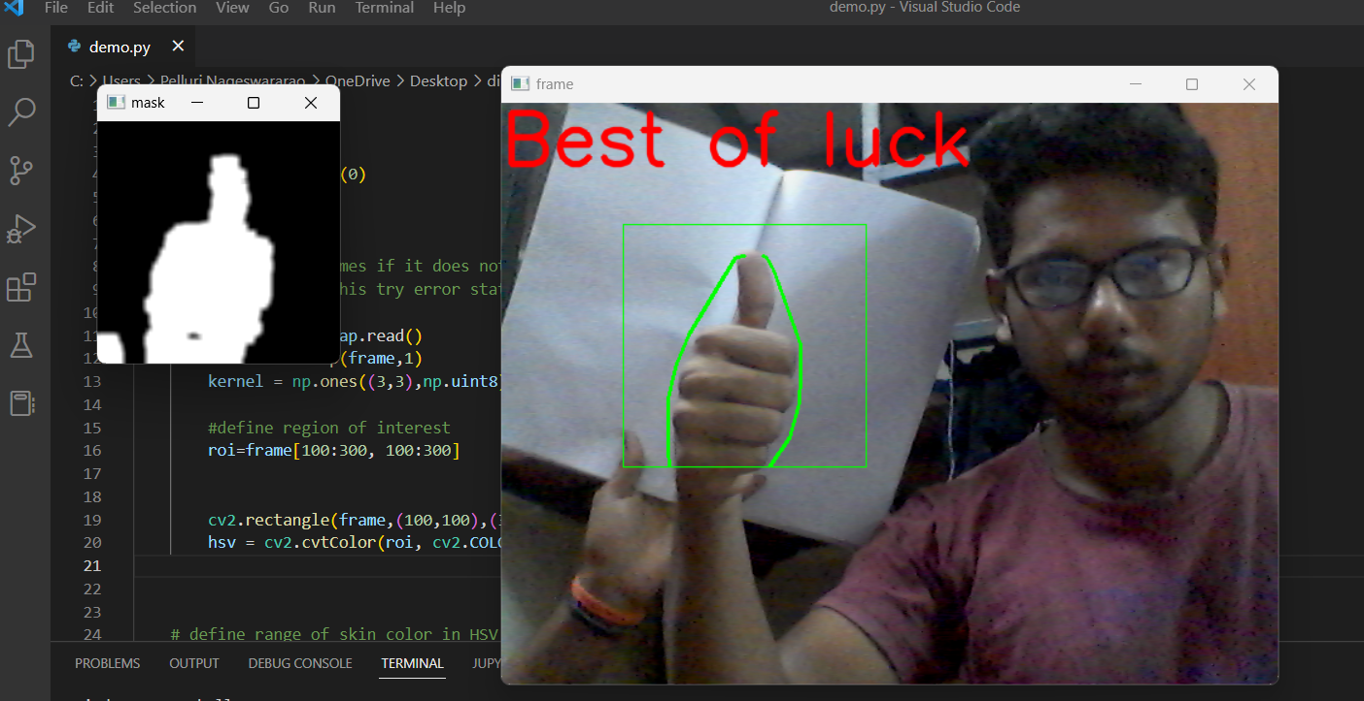
OUTPUT:
Best of Luck:

Slide 11
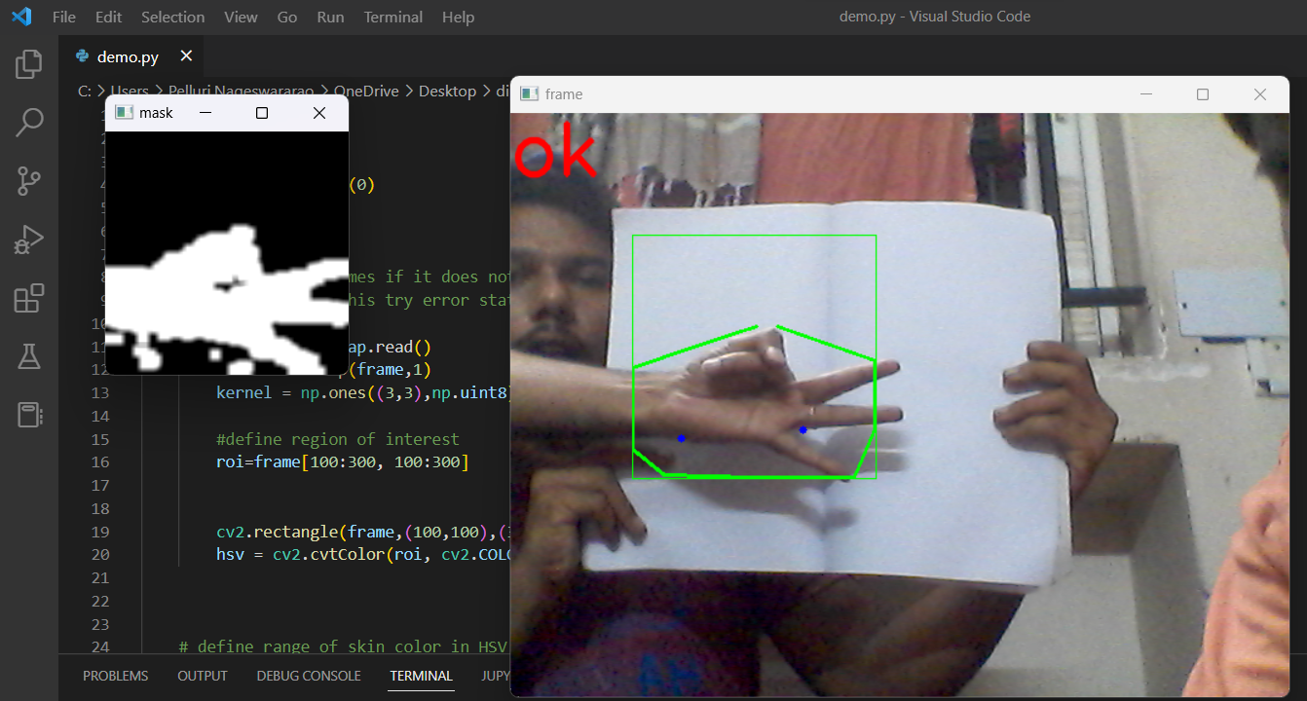
OK:

Slide 12
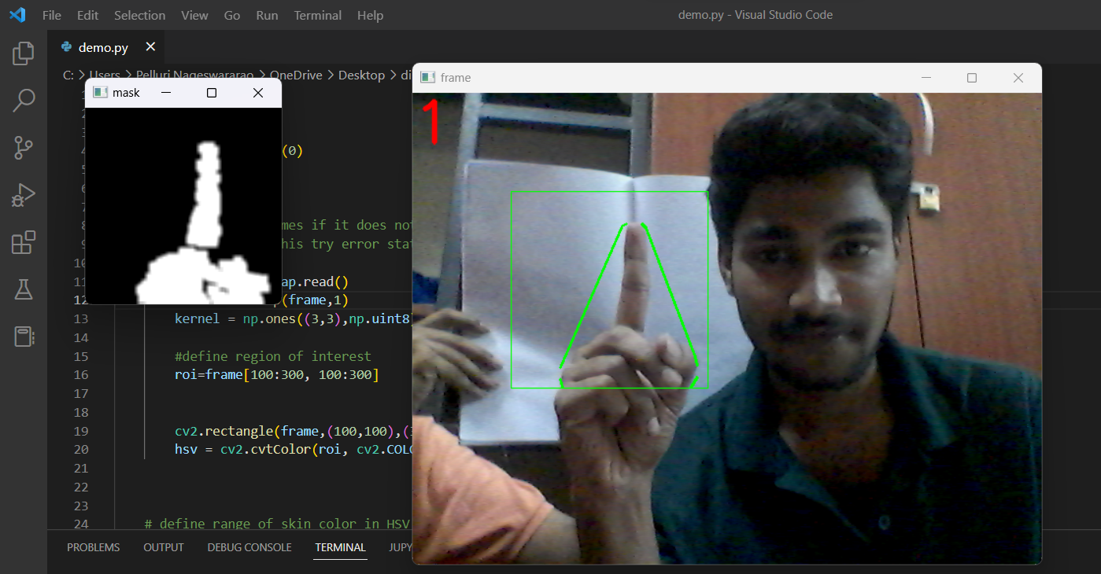
1:

Slide 13
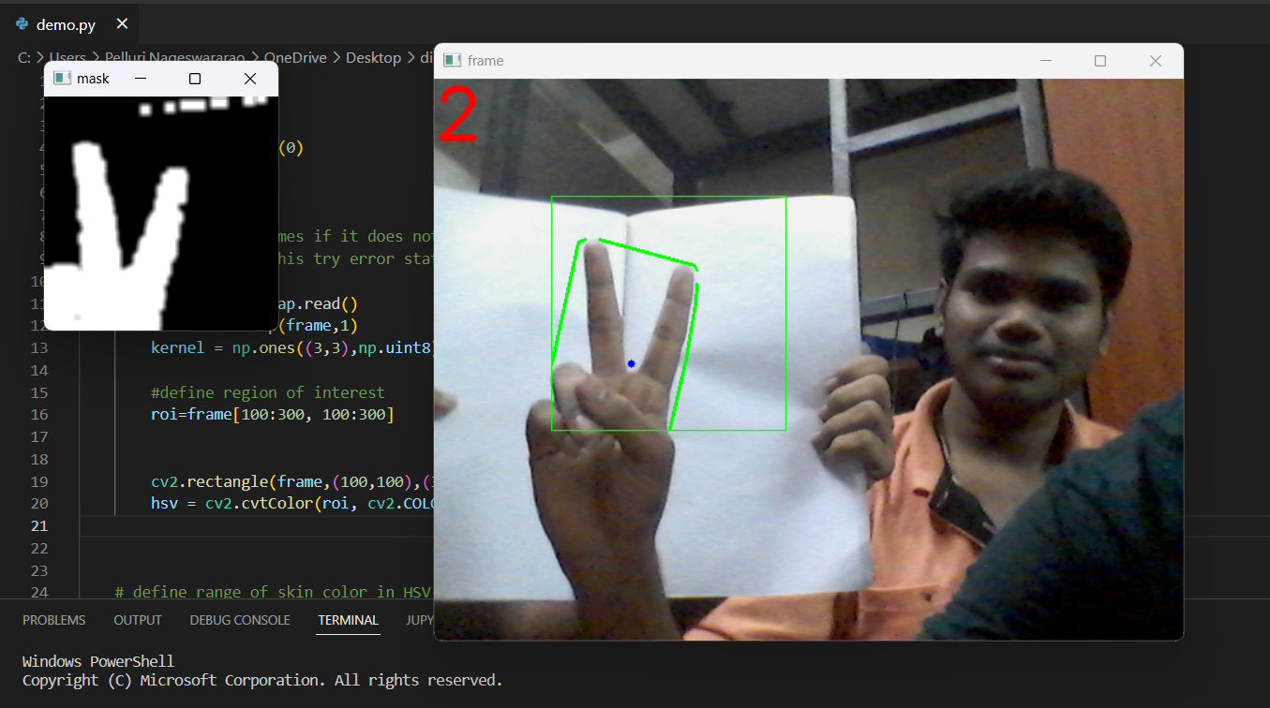
2:

Slide 14
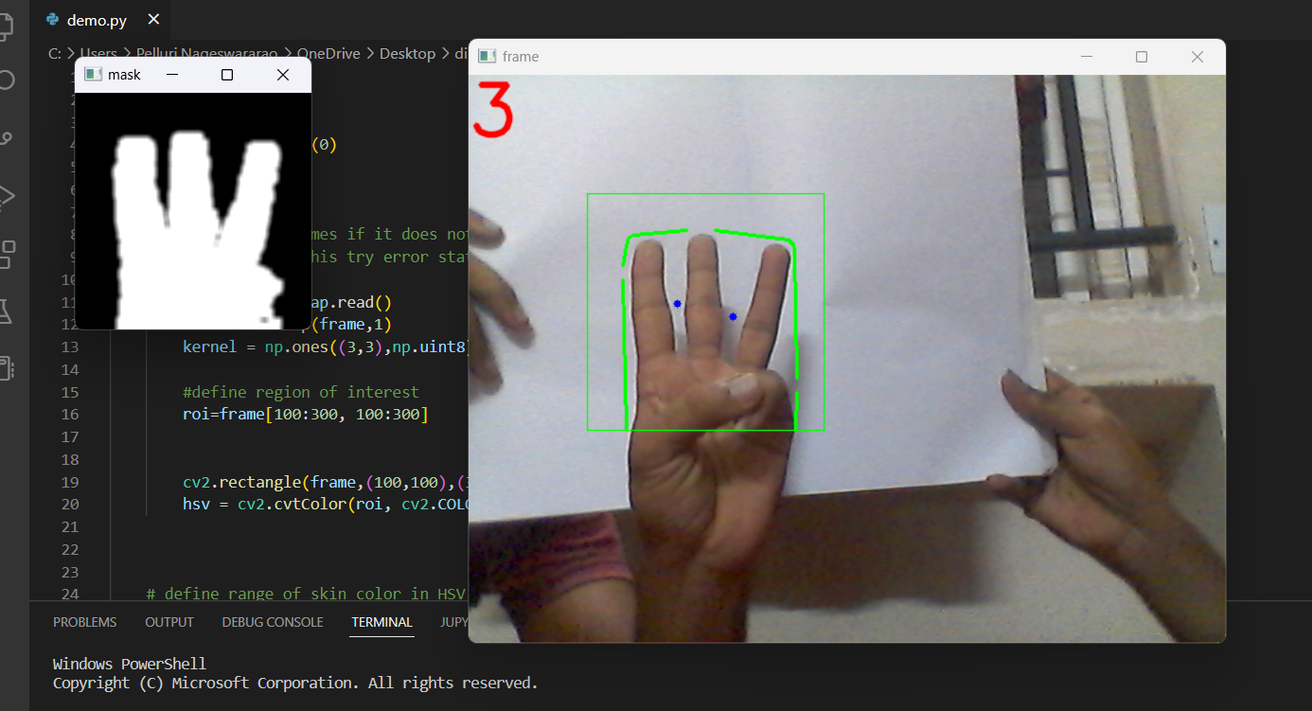
3:

Slide 15
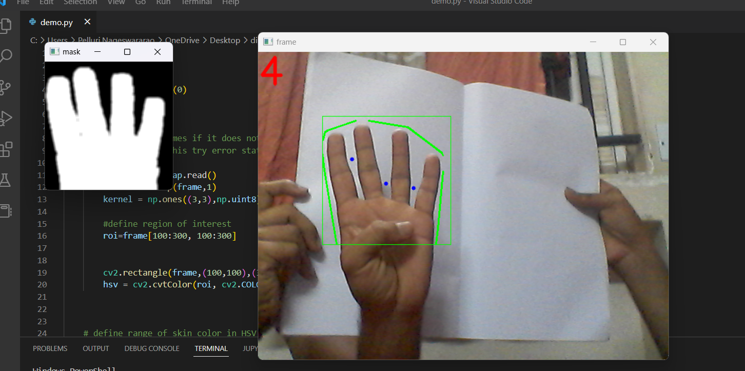
4:

Slide 16
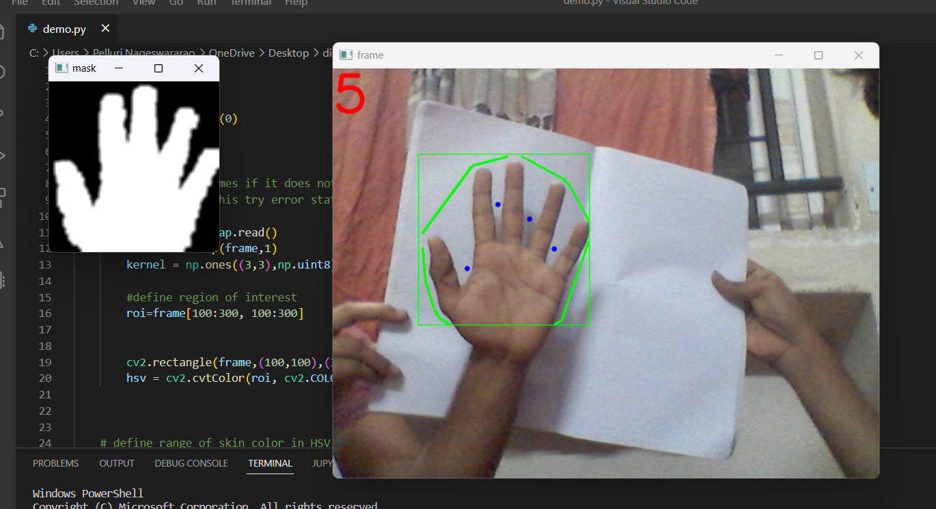
5:

Slide 17
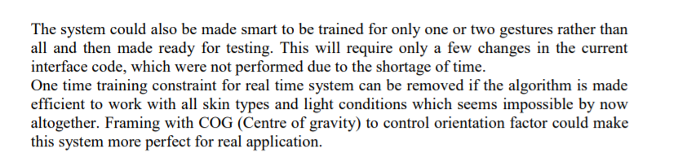
SCOPE FOR FUTURE ENHANCEMENT:

Slide 18
Conclusion:
One of the problems in gesture recognition is dealing with the image background and the noise often present in the regions of interest, such as the hand region. The use of neural networks for color segmentation, followed by morphological operations and a polygonal approximation, presented excellent results as a way to separate the hand region from the background and to remove noise. This step is important because it removes image objects that are not relevant to the classification method, allowing the convolutional neural network to extract the most relevant gesture features through their convolution and pooling layers and, therefore, to increase network accuracy. The proposal to make a logical AND operation with the segmentation masks and the original images provided the relevant information of the palms and fingers. Thus, the proposed CNN architectures achieved high success rates at a relatively low computational cost. It was superior to methodologies mentioned in related works, confirming the robustness of the presented method. In addition, the proposed architectures reached accuracies very similar to the architectures already defined in the literature, although they are much simpler and have a lower computational cost. This is possible due to the proposed image processing methodology, in which unnecessary information is removed, allowing improved feature extraction by the CNN. The proposed methodology and CNN architecture open the door to a future implementation of gesture recognition in embedded devices with hardware limitations. The proposed methodology approaches only cases of gestures present in static images, without hand detection and tracking or cases of hand occlusion. In the future, we intend to work on these particular cases in a new data preprocessing methodology, investigating other techniques of color segmentation and deep learning architectures

Slide 19
Result:
The results of the experiments were obtained by classifying two image sets, a self-acquired dataset and another set available in the literature . The self-acquired dataset was built by capturing the static gestures of the American Sign Language (ASL) alphabet, from 8 people, except for the letters J and Z, since they are dynamic gestures. To capture the images, we used a Logitech Brio webcam, with a resolution of 1920 × 1080 pixels, in a university laboratory with artificial lighting. By extracting only the hand region, we defined an area of 400 × 400 pixels for the final image of our dataset. To increase the dataset variety, we applied 30-degree rotations to all images, clockwise and counterclockwise, and a vertical scaling increase of 20%. Thus, the final image set is represented by 24 gestures and a total of 11100 samples. Such a large number of samples provided a variety of shapes and skin tones, which shows several samples of gesture .

Slide 20
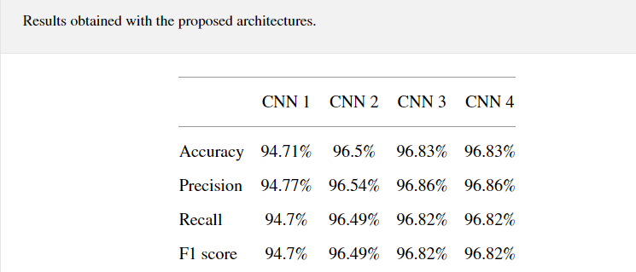
The proposed architectures use the activation rectified linear units (ReLUs) function in their convolution and pooling layers. In order to classify the features extracted by the defined CNN architectures, we adopted an MLP with 400 and 800 neurons in its two intermediate layers, using a ReLU activation function and a softmax output layer with 24 neurons. Other tests were performed with CNN architectures known in the literature, such as LeNet, InceptionResNetV2, InceptionV3, VGG16, VGG19, ResNet50, and DenseNet201. Our experiments used the holdout cross-validation method. Therefore, we adopted a division of 75% and 25% for training and testing, respectively, as defined in Kohavi [36]. From the 75% of data used for training, 5% were reserved for validation during training. Also, ten rounds of training and testing were adopted, in which the training and test sets were randomly permuted. The holdout metrics were obtained by averaging the results of the 10 rounds, using accuracy, recall, and F1 score. The tests were run on a server with configuration Intel (R) Core i7-6800K @ 3.40 GHz CPU, 64 GB of RAM, and two NVIDIA Titan Xp GPUs. .

Slide 21
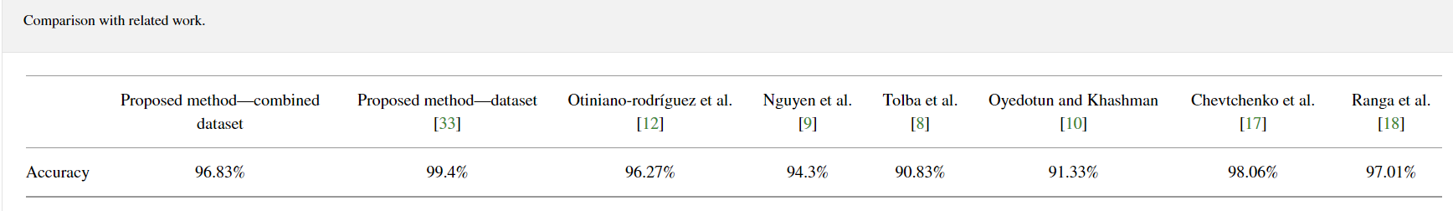
The proposed method results were superior to other methods that use the same method of classification of gestures, such as . Thus, the success rate of 96.83% shows the robustness of the presented methodology, the importance of preparing the images before the classification process and the need to study and analyse the types of convolutional neural network architectures. When using only dataset [33], we obtained higher accuracy rates than [17, 18], as we can see in Tables 4 and 6. In the proposed methodology with a combined dataset, when we use our own set and [33] to increase the diversity of hands, we obtained a slightly lower accuracy. But, in this way, we can demonstrate that our methodology is able to adapt to a greater variety of hand data.

Slide 22
References
National Research Council, How People Learn: Brain, Mind, Experience, and School: Expanded Edition, The National Academies Press, Washington, DC, USA, 2000.View at: Publisher Site
M. W. Cohen, N. B. Zikri, and A. Velkovich, “Recognition of continuous sign language alphabet using leap motion controller,” in Proceedings of the 2018 11th International Conference on Human System Interaction (HSI), pp. 193–199, Gdańsk, Poland, July 2018.View at: Google Scholar
A. Betancourt, P. Morerio, C. S. Regazzoni, and M. R. Auterberg, “A structure for deoxyribose nucleic acid,” Circuits and Systems for Video Technology, vol. 25, no. 5, pp. 744–760, 2015.View at: Google Scholar
S. Riofrío, D. Pozo, J. Rosero, and J. Vásquez, “Gesture recognition using dynamic time warping and kinect: a practical approach,” in Proceedings of the 2017 International Conference on Information Systems and Computer Science (INCISCOS), pp. 302–308, Quito, Ecuador, November 2017.View at: Google Scholar
Technavio, Global Robotics Market 2015–2019, Research and Markets, Dublin, Ireland, 2015.
P. K. Pisharady and M. Saerbeck, “Recent methods and databases in vision-based hand gesture recognition: a review,” Computer Vision and Image Understanding, vol. 141, no. 4356, pp. 152–165, 2015.View at: Google Scholar
N. A. Ming-Hsuan Yang and M. Tabb, “Extraction of 2d motion trajectories and its application to hand gesture recognition,” IEEE Transactions on Pattern Analysis and Machine Intelligence, vol. 24, no. 8, pp. 1061–1074, 2002.View at: Google Scholar
A. S. Tolba, M. A. Elsoud, and O. A. Elnaser, “LVQ for hand gesture recognition based on DCT and projection features,” Journal of Electrical Engineering, vol. 60, no. 4, pp. 204–208, 2009.View at: Google Scholar
T.-N. Nguyen, H.-H. Huynh, and J. Meunier, “Static hand gesture recognition using principal component analysis combined with artificial neural network,” Journal of Automation and Control Engineering, vol. 3, no. 1, 2015.View at: Google Scholar
O. K. Oyedotun and A. Khashman, “Deep learning in vision-based static hand gesture recognition,” Neural Computing and Applications, vol. 28, no. 12, pp. 3941–3951, 2017.View at: Google Scholar

Slide 23
11.D.-Y. Huang, W.-C. Hu, and S.-H. Chang, “Gabor filter-based hand-pose angle estimation for hand gesture recognition under varying illumination,” Expert Systems with Applications, vol. 38, no. 5, pp. 6031–6042, 2011.View at: Publisher Site | Google Scholar
12. K. C. Otiniano-Rodríguez, G. Camara-Chávez, and D. Menotti, “Hu and zernike moments for sign language recognition,” in Proceedings of the International Conference on Image Processing, Computer Vision, and Pattern Recognition (IPCV), November 2012.View at: Google Scholar
13 .M. V. den Bergh, D. Carton, R. De Nijs et al., “Real-time 3D hand gesture interaction with a robot for understanding directions from humans,” in Proceedings of the 2011 20th IEEE International Symposium on Robot and Human Interactive Communication (RO-MAN), pp. 357–362, Atlanta, GA, USA, July 2011.View at: Google Scholar
14. Triesch and C. von der Malsburg, “A system for person-independent hand posture recognition against complex backgrounds,” IEEE Transactions on Pattern Analysis and Machine Intelligence, vol. 23, no. 12, pp. 1449–1453, 2001.View at: Publisher Site | Google Scholar
15. S. S. Ge, Y. Yang, and T. H. Lee, “Hand gesture recognition and tracking based on distributed locally linear embedding,” in Proceedings of the 2006 IEEE Conference on Robotics, Automation and Mechatronics, vol. 171, no. 4356, pp. 1–6, Orlando, FL, USA, June 2006.View at: Google Scholar
16. P. K. Pisharady and M. Saerbeck, “Recent methods and databases in vision-based hand gesture recognition: a review,” Computer Vision and Image Understanding, vol. 141, pp. 152–165, 2015.View at: Publisher Site | Google Scholar
17. S. F. Chevtchenko, R. F. Vale, V. Macario, and F. R. Cordeiro, “A convolutional neural network with feature fusion for real-time hand posture recognition,” Applied Soft Computing, vol. 73, pp. 748–766, 2018.View at: Publisher Site | Google Scholar
18. V. Ranga, N. Yadav, and P. Garg, “American sign language fingerspelling using hybrid discrete wavelet transform-gabor filter and convolutional neural network,” Journal of Engineering Science and Technology, vol. 13, no. 9, pp. 2655–2669, 2018.View at: Google Scholar
19. Suzuki and K. Be, “Topological structural analysis of digitized binary images by border following,” Computer Vision, Graphics, and Image Processing, vol. 30, no. 1, pp. 32–46, 1985.View at: Publisher Site | Google Scholar
20. U. Ramer, “An iterative procedure for the polygonal approximation of plane curves,” Computer Graphics and Image Processing, vol. 1, no. 3, pp. 244–256, 1972.View at: Google Scholar

Slide 24
THANK YOU

